Slide 1
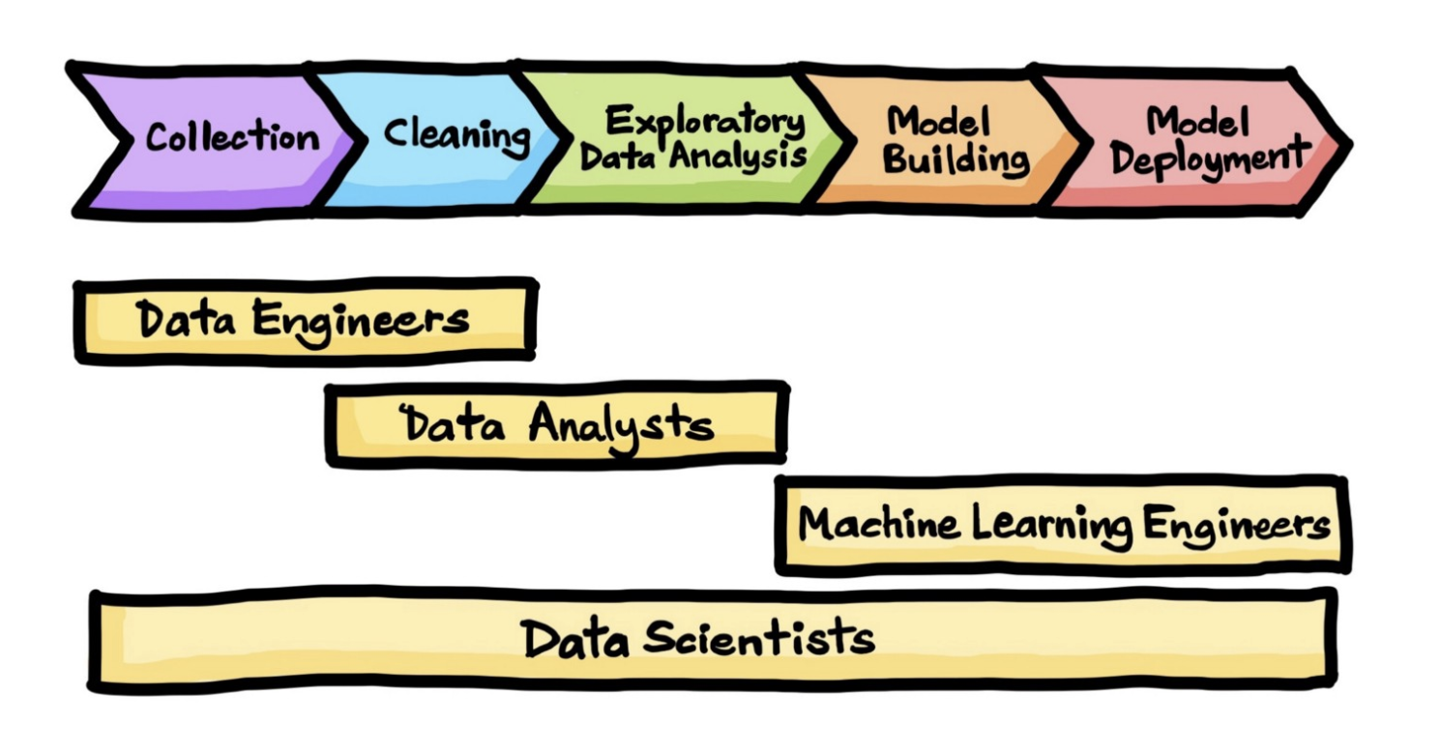
INTEGRATED PROJECT
Explore AI – DATA SCIENCE Date: 12 November 2023
Name: lebogang phalane

Slide 2
1.5. Project landscape
Data
Information
Knowledge
Insurance policies
Insurance claims
Insurance premiums
Why should I spend money now for a risk that might not happen?
Who can I target and where.
Insurance is too expensive.
Minimize the cost of insurance.

